Slide 1
DEFENSE MECHANISMS OF THE GINGIVA GINGIVAL CREVICULAR FLUID LEUKOCYTES SALIVA
RUNGTA COLLEGE OF DENTAL SCIENCES AND RESEARCH,BHILAI

Slide 2
SPECIFIC LEARNING OBJECTIVES
CORE AREAS | DOMAIN | CATEGORY
INTRODUCTION | Affective | Desire to know
DEFINITION | Cognitive | Must to know
HISTORY | Cognitive | Must to know
MECHANISM OF GCF PRODUCTION | Cognitive | Must to know
MECHANISM OF GCF COLLETION | Cognitive | Must to know
METHODS OF ESTIMATING GCF | Cognitive | Must to know
COMPOSITION OF GCF | Cognitive | Must to know
CLINICAL SIGNIFICANCE OF GCF | Cognitive | Must to know
SALIVA | Cognitive | Must to know

Slide 3
CONTENT
PART I
INTRODUCTION
DEFINITION
HISTORY
MECHANISM OF GCF PRODUCTION
MECHANISM OF GCF COLLETION
PART II
METHODS OF ESTIMATING GCF
COMPOSITION OF GCF
CLINICAL SIGNIFICANCE OF GCF
SALIVA

Slide 4
Methods of estimating the GCF volume collected

Slide 5
The amount of GCF collected on a strip was assessed by the distance the fluid had migrated up the strip.
A more accurate value was achieved by assessing the area of filter paper wetted by the GCF sample.
Further accuracy was achieved by staining the strips with ninhydrin to produce a purple color in the area where GCF had accumulated
Cimasoni et al 1983
Notes:
2g fluorescein given systemically to each patient 2 hours prior to the collection of GCF, following which the strips were examined under ultraviolet light. Although they used this technique to determine presence or absence of fluid, rather than to quantify the volume collected, they found that fluorescein labeling was 100 times more sensitive than ninhydrin for staining protein

Slide 6
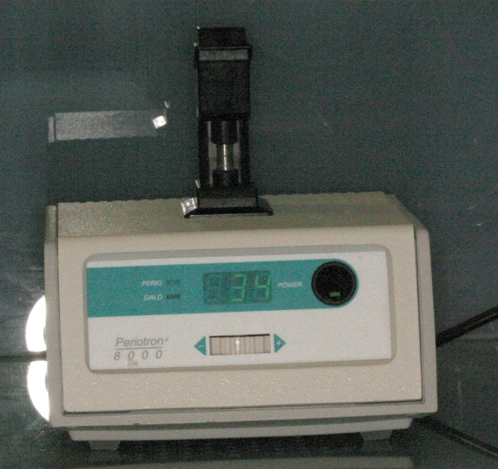
PERIOTRON
An electronic measuring device that allows accurate determination of the GCF volume and subsequent laboratory investigation of the sample composition.
Three models of Periotron have been produced: the 600, 6000 and now the 8000

Slide 7
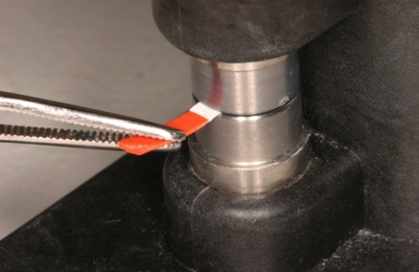
The instrument measures the affect on the electrical current flow of the wetted paper strips.
The wetness of the paper strip affects the flow of an electronic current and gives a digital readout.

Slide 8
Limitations of the Periotron:
Inability to measure volumes of GCF greater than 1.0ml, although when using filter strips such as Whatman 3MM strips, the strips themselves are capable of absorbing much larger volumes.

Slide 9
Amount of GCF collected
The amount of GCF collected is extremely small.
Measurements performed by Cimasoni showed that a strip of paper 1.5 mm wide and inserted 1mm within the gingival sulcus of a slightly inflammed gingiva absorbs about 0.1 mg of GCF in 3 min.

Slide 10
Challacombe used an isotope dilution method to measure amount of GCF , which showed that mean GCF volume in proximal spaces from molar teeth ranged from 0.43 to 1.56 µl

Slide 11
Problems with GCF Collection and Data Interpretation
Contamination
Blood, saliva, plaque
Sampling time
Periotron....5 seconds
change with the protein concentration
Volume determination
Evaporation
centrifugal elution technique
Recovery from strips
Data reporting
absolute amounts (mg ), concentrations ( mg/ml ) or either of these two with respect to pocket depth or duration of sample collection.

Slide 12
GCF flow rates in health and disease
 | GCF flow rates
Shallow sulci in healthy subjects | 3–8 µl/h
Pockets with intermediate periodontal disease | 20 µl/h.
GCF flow at sites with advanced periodontal disease | 137 µl/h

Slide 13
COMPOSITION OF THE GCF

Slide 14
Cellular elements
Electrolytes
Organic compounds
Metabolic and bacterial products
Enzymes and enzyme inhibitors

Slide 15
The major cellular components of the gingival crevicular fluid:
Bacteria..... Adjacent plaque mass
Epithelial cells.....Oral sulcular and junctional epithelium
Leukocytes.....Gingival plexus of blood vessels
Erythrocytes.....Blood vessels

Slide 16
The anatomical origin of the cells of the GCF:

Slide 17
Electrolytes
Potassium, Sodium and Calcium have been studied in GCF.

Slide 18
Organic compounds
Carbohydrates, proteins and lipids have been investigated.
Glucose hexosamine and hexuronic acid are two of the compounds found in gingival fluid.
Glucose concentration in gingival fluid is 3-4 times greater than that in serum.

Slide 19
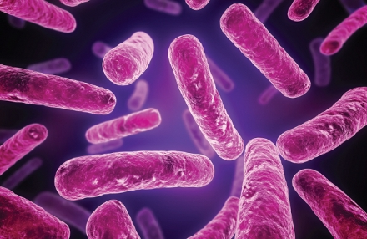
Metabolic and bacterial products
Lactic acid
Urea
Hydroxyproline
Cytotoxins
Hydrogen sulphide
Antibacterial factors

Slide 20
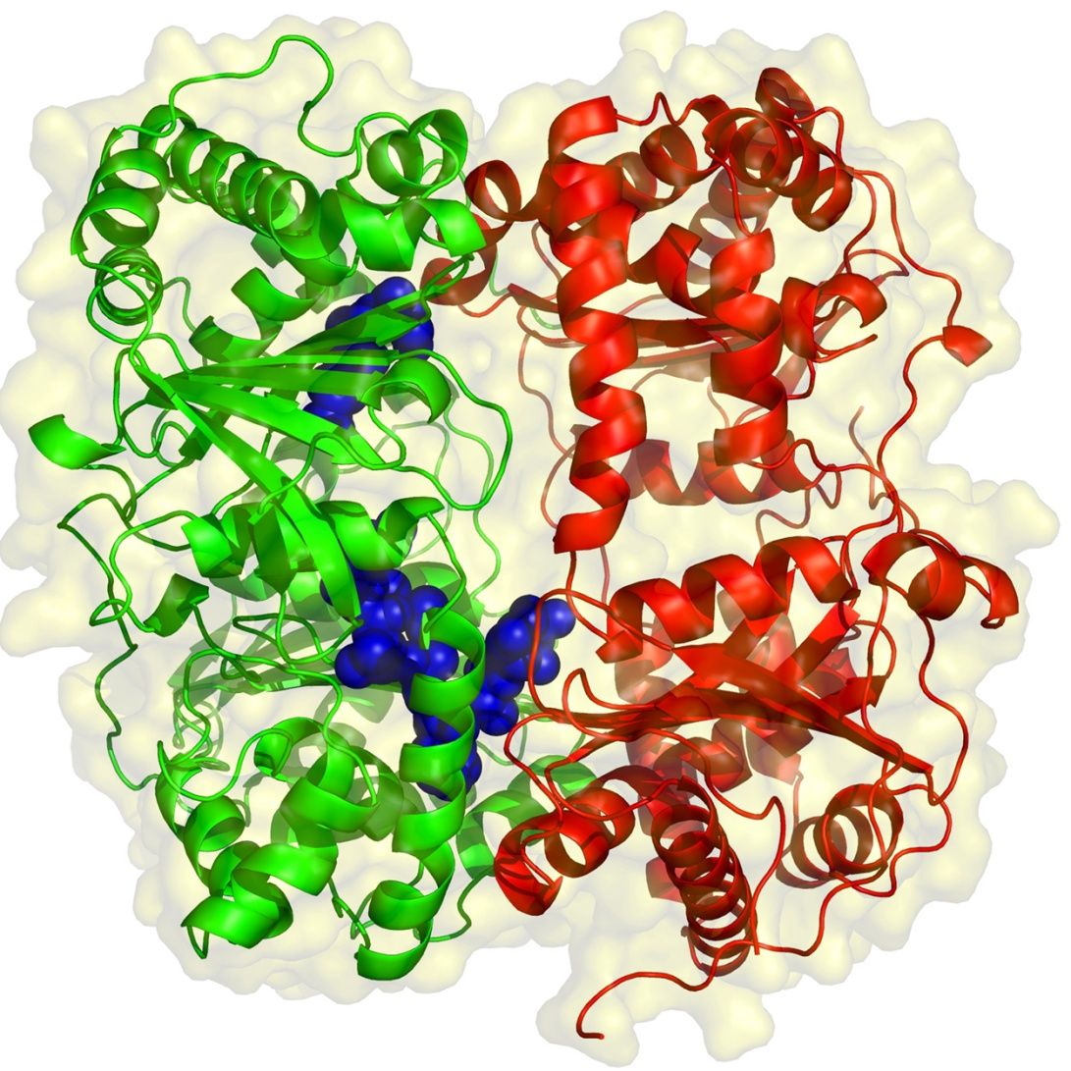
Enzymes and enzyme inhibitors
Acid and Alkaline Phosphatase
Beta-glucoronidase
Lysozyme
Hyaluronidase
Proteolytic enzymes

Slide 21
Clinical significance of GCF

Slide 22
Circadian Periodicity
There is a gradual increase in GCF amount from 6 AM to 10 PM and a decrease afterward.
Sex Hormones
Female sex hormones increase GCF flow, probably because they enhance vascular permeability.
Pregnancy, ovulation, and hormonal contraceptives all increase gingival fluid production.

Slide 23
Mechanical Stimulation
Chewing and vigorous gingival brushing stimulate the flow of GCF. Even the minor stimuli represented by intrasulcular placement of paper strips increases the production of fluid.
Smoking
Smoking produces an immediate transient but marked increase in GCF flow.
Periodontal Therapy
There is an increase in GCF production during the healing period after periodontal surgery.

Slide 24
Drugs in Gingival Crevicular Fluid
Drugs that are excreted through the GCF may be used advantageously in periodontal therapy.
Bader and Goldhaber 1966 demonstrated in dogs that tetracyclines are excreted through the GCF;
Metronidazole

Slide 25
Commercially available diagnostic aids

Slide 26
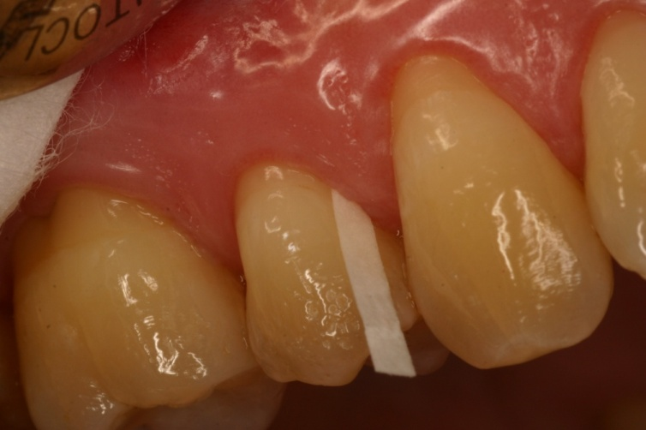
PERIOCHECK
Detects collagenase
PROGNOSTIK
Detects elastase
PERIOGARD
To detect AST

Slide 27
SALIVA

Slide 28
Salivary secretions are protective in nature because they maintain the oral tissues in a physiologic state.
Saliva exerts a major influence on plaque by mechanically cleansing the exposed oral surfaces, by buffering acids produced by bacteria, and by controlling bacterial activity.

Slide 29
Antibacterial Factors
Inorganic factors
Organic factors
ions and gases, bicarbonate, sodium, potassium, phosphates, calcium, fluorides, ammonium, and carbon dioxide.
lysozyme, lactoferrin, myeloperoxidase, lactoperoxidase, and agglutinins such as glycoproteins, mucins,β2-macroglobulins, fibronectins, and antibodies.

Slide 30
Lysozyme is a hydrolytic enzyme that cleaves the cell wall of certain bacteria and works on both gram-negative and gram-positive organisms.
Lactoperoxidase-thiocyanate system in saliva has been shown to be bactericidal to some strains of Lactobacillus and Streptococcus.

Slide 31
Lactoferrin, which is effective against Actinobacillus species.
Myeloperoxidase, an enzyme is released by leukocytes and is bactericidal for Actinobacillus and also inhibits the attachment of Actinomyces strains to hydroxyapatite

Slide 32
Salivary Antibodies
IgA
preponderant immunoglobulin found in saliva
produced by the salivary glands.
can inhibit the attachment of oral Streptococcus species to epithelial cells.
IgG and IgM

Slide 33
Salivary Enzymes
parotid amylase….. Major enzyme derived from the salivary glands, bacteria, leukocytes, oral tissues, and ingested substances.
Salivary enzymes that increases in concentrations in periodontal disease:
Hyaluronidase and lipase, β-glucuronidase and chondroitin sulfatase, amino acid decarboxylases, catalase, peroxidase, and collagenase, and various antiproteases enzymes.

Slide 34
Salivary glycoproteins inhibit the sorption of some bacteria to the tooth surface and to epithelial cells of the oral mucosa.
Mucin helps in the deletion of bacterial cells from the oral cavity by aggregation with mucin-rich films.

Slide 35
Salivary Buffers and Coagulation Factors
Maintenance of physiologic hydrogen ion concentration (pH) at the mucosal epithelial cell surface and the tooth surface is an important function of salivary buffers.
Important salivary buffer is the bicarbonate-carbonic acid system.

Slide 36
Saliva also contains coagulation factors (factors VIII, IX, and X; plasma thromboplastin antecedent [PTA]; Hageman factor) that hasten blood coagulation and protect wounds from bacterial invasion.

Slide 37
LEUCOCYTES

Slide 38
The leukocytes found are predominantly PMNs.
They appear in small numbers extravascularly in the connective tissue adjacent to the bottom of the sulcus; from there, they travel across the epithelium to the gingival sulcus, where they are expelled

Slide 39
Living PMNs in saliva are sometimes referred to as orogranulocytes, and their rate of migration into the oral cavity is termed the orogranulocytic migratory rate.
The majority of these cells are viable and have phagocytic and killing capacity. Therefore, leukocytes constitute a major protective mechanism against the extension of plaque into the gingival sulcus by killing periodontal pathogens

Slide 40
SUMMARY
The presence of GCF or sulcular fluid has been known since
19th century and its compostion and possible role in oral
defense mechanisms were elucidated by the pioneering work of
Waerhaug and Brill and Krasse.
• In strictly normal gingiva little or no fluid can be collected.
• GCF can be collected intrasulcular method and extrasulcular
Method.
Saliva secretions are protective in nature because they maintain
the oral tissues in physiologic state.
• It has antibacterial, lubricating, cleansing, and buffering action.
It also helps in physical protection and tooth integrity.

Slide 41
REFERENCE
Newman MG, Takei HH, Klokkevold PR, Carranza FA. Carranza’s clinical periodontology, 10th ed. Saunders Elsevier; 2007.
Lindhe J, Lang NP and Karring T. Clinical Periodontology and Implant Dentistry. 6th ed. Oxford (UK): Blackwell Publishing Ltd.; 2015.
Newman MG, Takei HH, Klokkevold PR, Carranza FA. Carranza’s clinical periodontology, 13th ed. Saunders Elsevier; 2018.

Slide 42
THANK YOU

